Slide 1
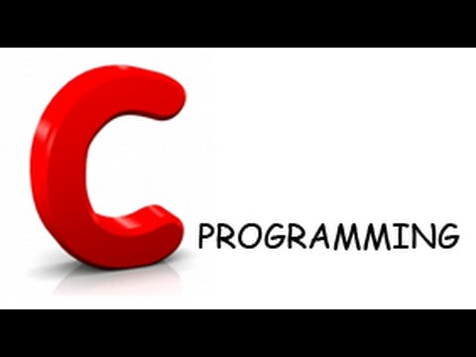
Shoukat Malik B.S Software Engineering SSUET Karachi
Introduction to C programming

Slide 2
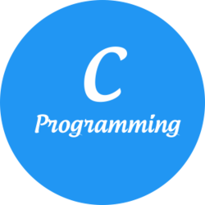
Why C language
History to C programming Language
Feature of C - Language

Slide 3

History of C Programming
International Groups
1960 ALGOL -60
CPL
Cambridge University
Type less Language
BCPL Martin Richards
1969 B Ken Thompson
Bell Labs
1972 C Dennis Ritchie
Type base language
It was developed to overcome the problems of previous languages such as B, BCPL etc.

Slide 4
C Language Standard
19 89 ANSI American National Standard Institute or C - 89
1990 ISO International Organization for Standardization or C - 90 .
1995 ISO C-95.
1999 ISO C-99
December 2011 C-11

Slide 5
Features of C Language
Low Level Features :
C Programming provides low level features that are generally provided by the Lower level languages. C is Closely Related to Lower level Language such as “Assembly Language“.
It is easier to write assembly language codes in C programming.

Slide 6
Portability :
C Programs are portable i.e. they can be run on any Compiler with Little or no Modification
Compiler and Preprocessor make it Possible for C Program to run it on Different PC
Powerful
Provides Wide verity of ‘Data Types‘
Provides Wide verity of ‘Functions’
Provides useful Control & Loop Control Statements

Slide 7
High Level Features :
It is more User friendly as compare to Previous languages. Previous languages such as BCPL, Pascal and other programming languages never provide such great features to manage data.
Previous languages have there pros and cons but C Programming collected all useful features of previous languages thus C become more effective language
A C program is basically a collection of functions that are supported by C library. We can also create our own function and add it to C library.
C language is the most widely used language in operating systems and embedded system development today

Slide 8
Bit Manipulation
It provides wide verity of bit manipulation Operators. We have bitwise operators to manage Data at bit level.

Slide 9
Different parts of C program.
Pre-processor
Header file
Function
Variables
expression
Comment
All these are essential parts of a C language program.
.

Slide 10
Pre-processor
The main work of pre-processor is to initialize the environment of program, i.e. to link the program with the header file. .e.g.
#include
Header file
Header file is a collection of built-in functions
To use any of the standard functions, the appropriate header file must be included
Example : <stdio.h ><conio.h >, <math.h >,<string.h >
main() function
main() function is a function that must be used in every C program.
A function is a sequence of statement required to perform a specific task. main() function starts the execution of C program.
Variables
Variable is the name of memory location

Slide 11
.

